Slide 1
How to make skill enhancement module
Grade Points System
By- Dr. Dinesh W. Nichit

Slide 2
Skill Enhancement Module

Slide 3
Illustrations of SEM in accounting course :-
How to create a cash book ?
To provide students Basic knowledge of cash book.
Like what do you mean by cash book ?
How Beneficial Cash book?
Objectives Of Cash Book:-
2. Types of Cash Books :-
Single column Cash Books.
Double Column Cash Books.
Triple Column Cash Books.
Petty Cash Books.
3. Format of Single Column Cash Book :-

Slide 4
Illustrations of SEM in accounting course :-
4. Format of Double Column Cash Book :-
5. Format of Triple Column Cash Book :-

Slide 5
Illustrations of SEM in accounting course :-
How to create a ledger book ?
To provide students Basic knowledge of ledger book.
Like what do you mean by Ledger book ?
How Beneficial Ledger book?
Objectives Of Ledger Book:-
2. Format of Ledger Book :-

Slide 6
Grades & Grade Points

Slide 7
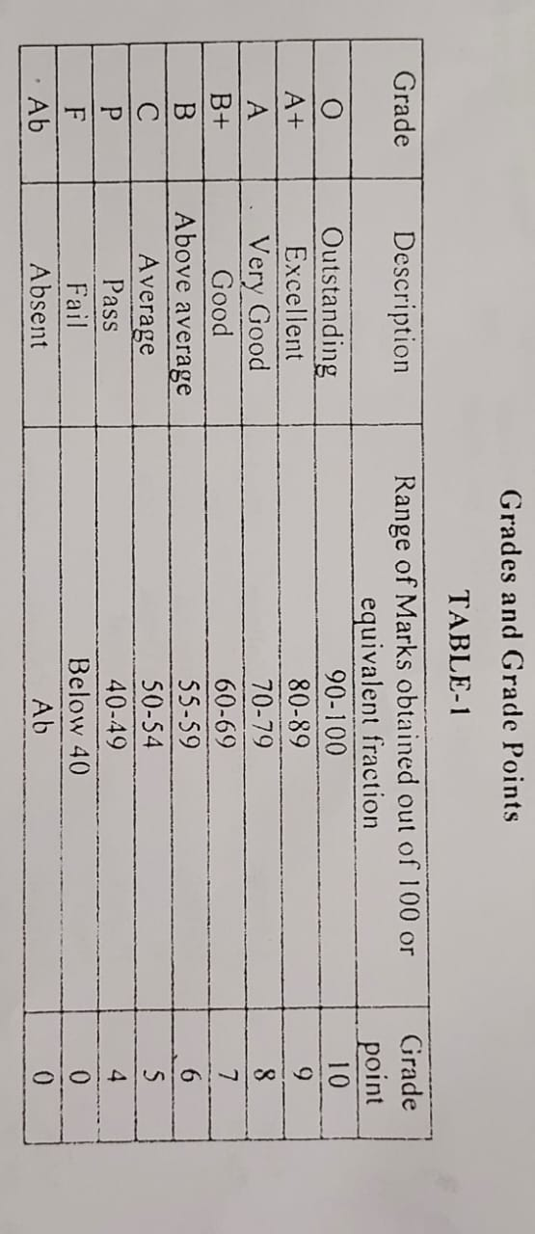

Slide 8
Thanks!

